Slide 1

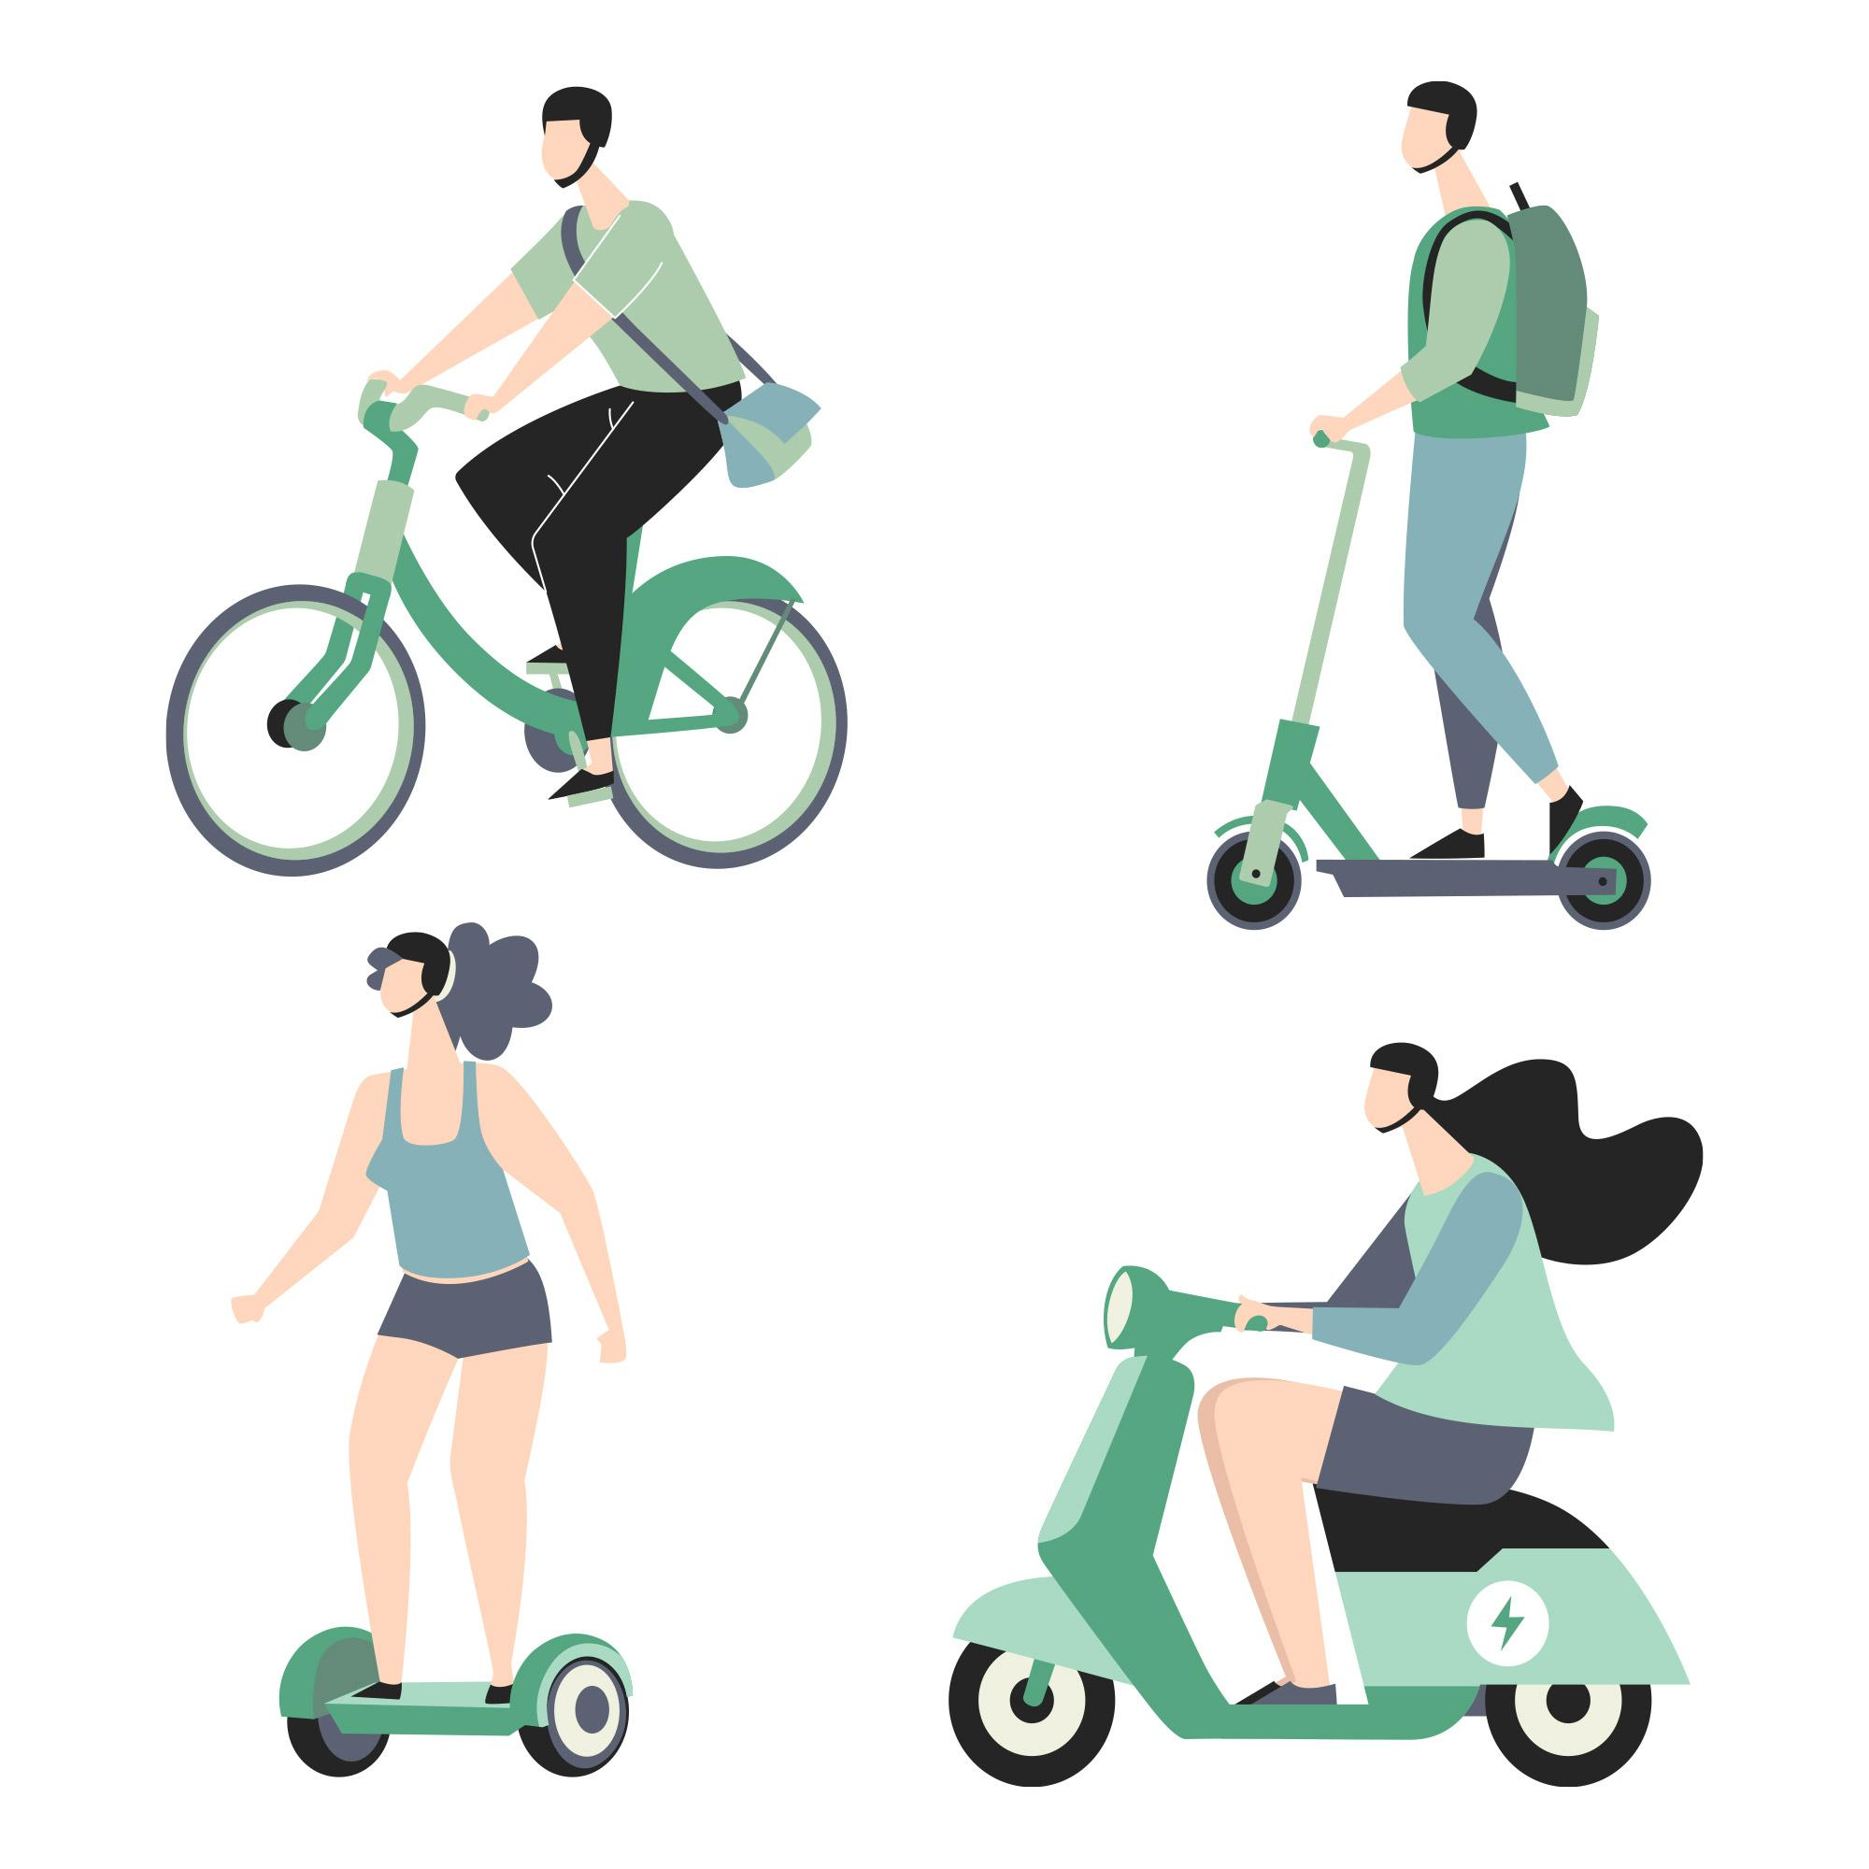
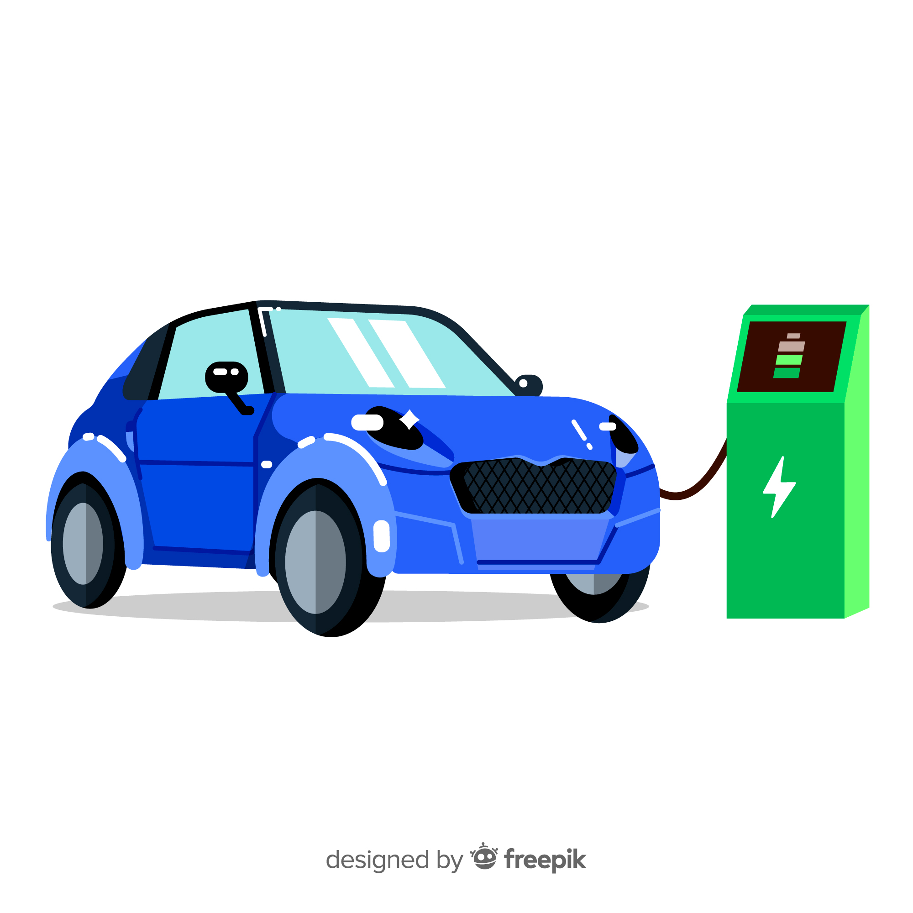

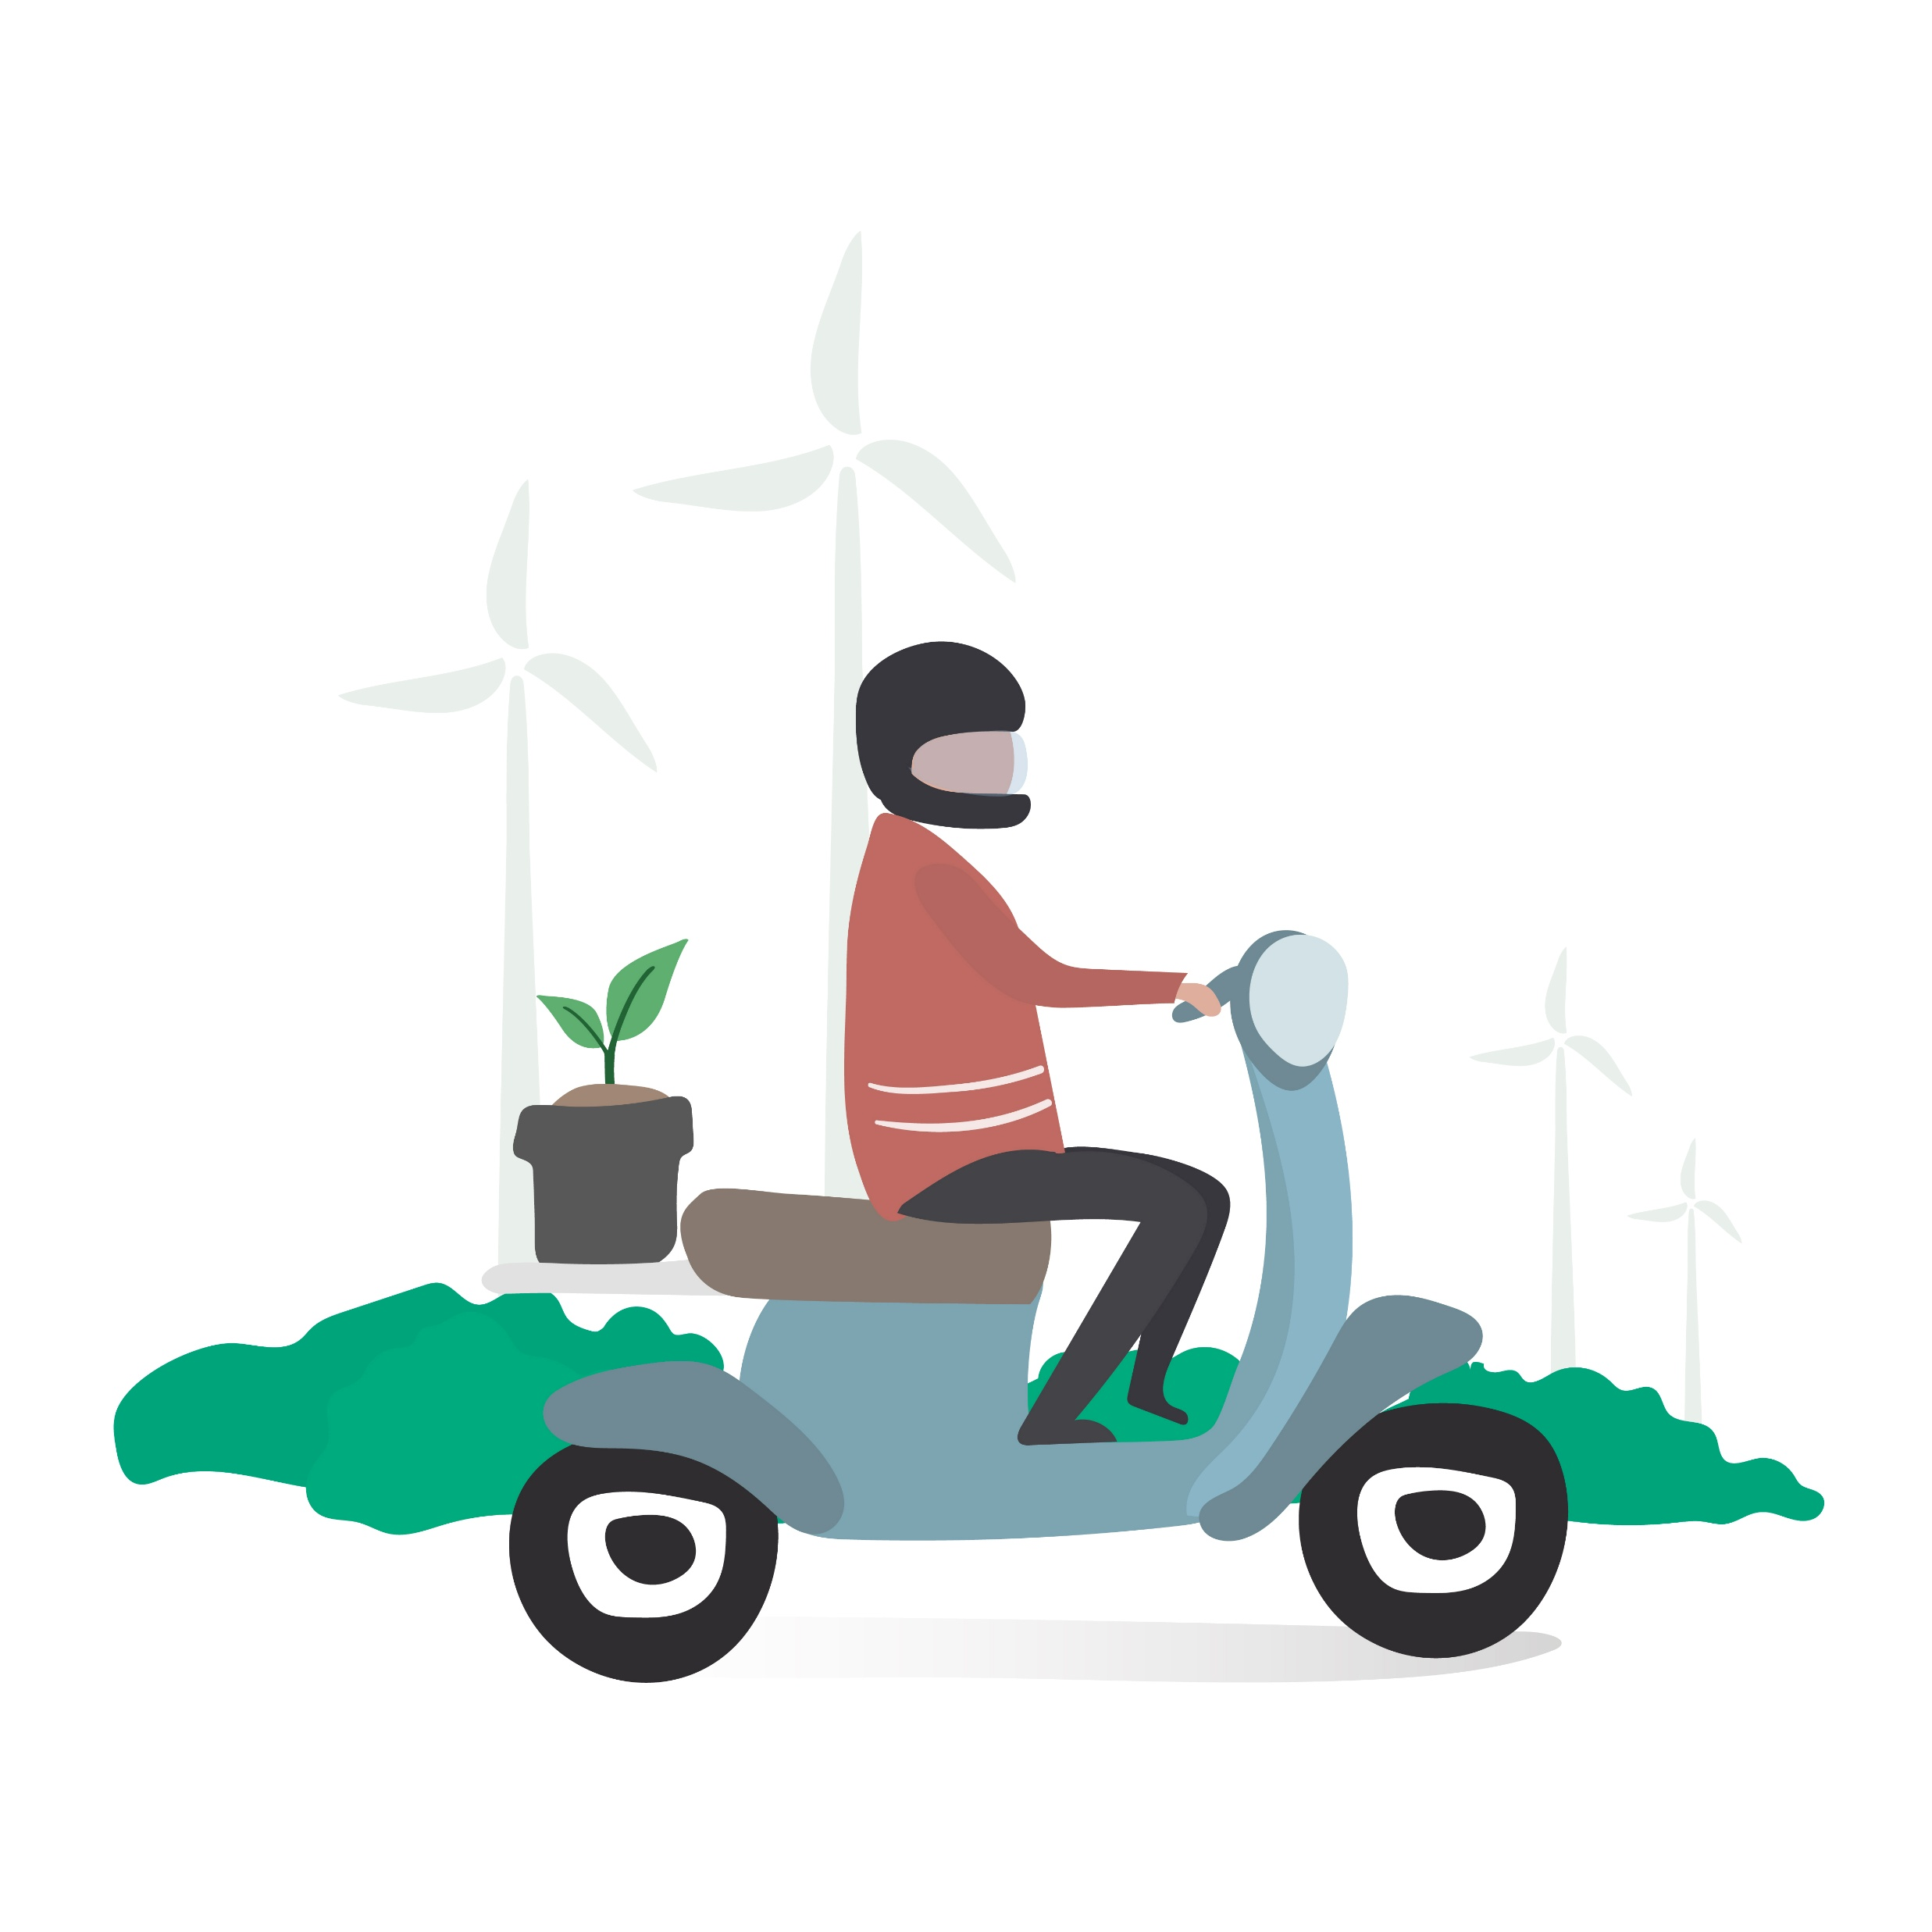
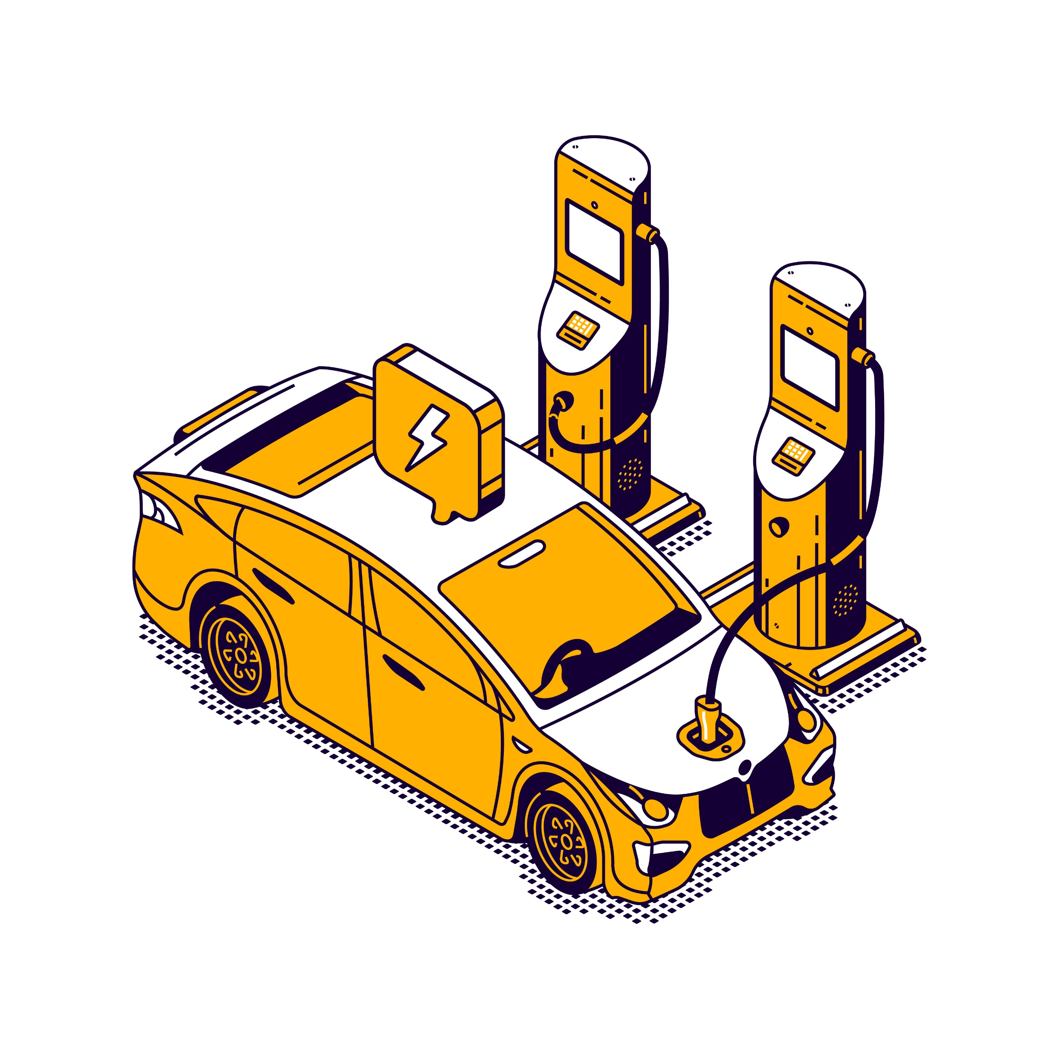
Electric Vehicles Analysis
Presentation by:
Akshaykumar Shalavadi

Slide 2
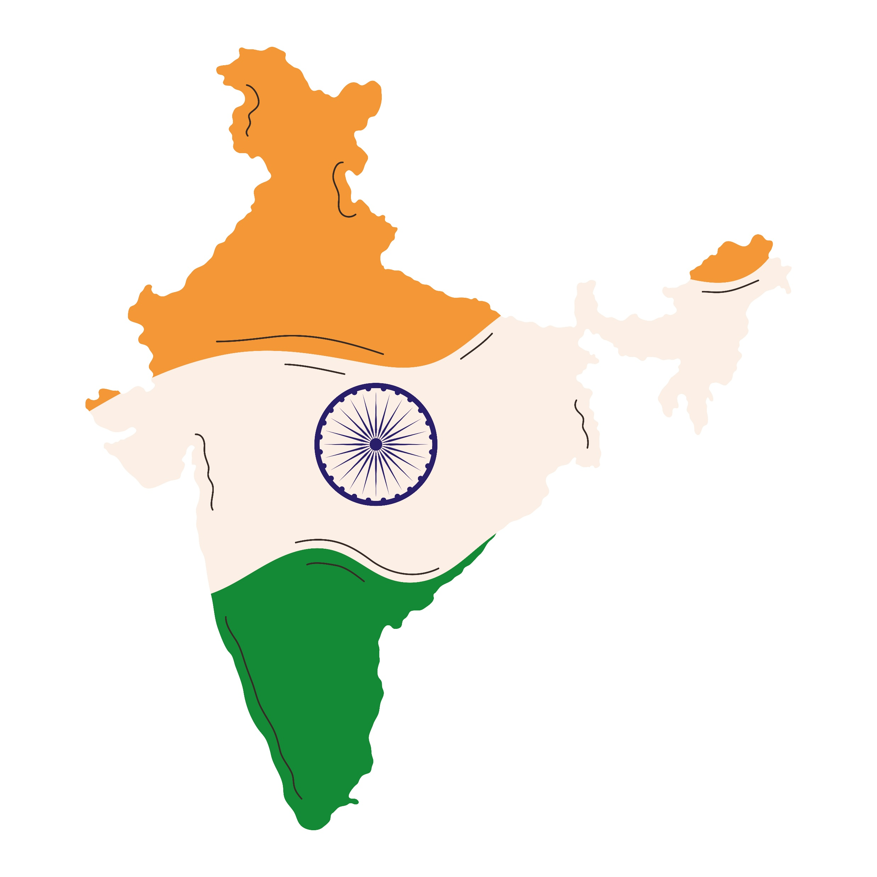
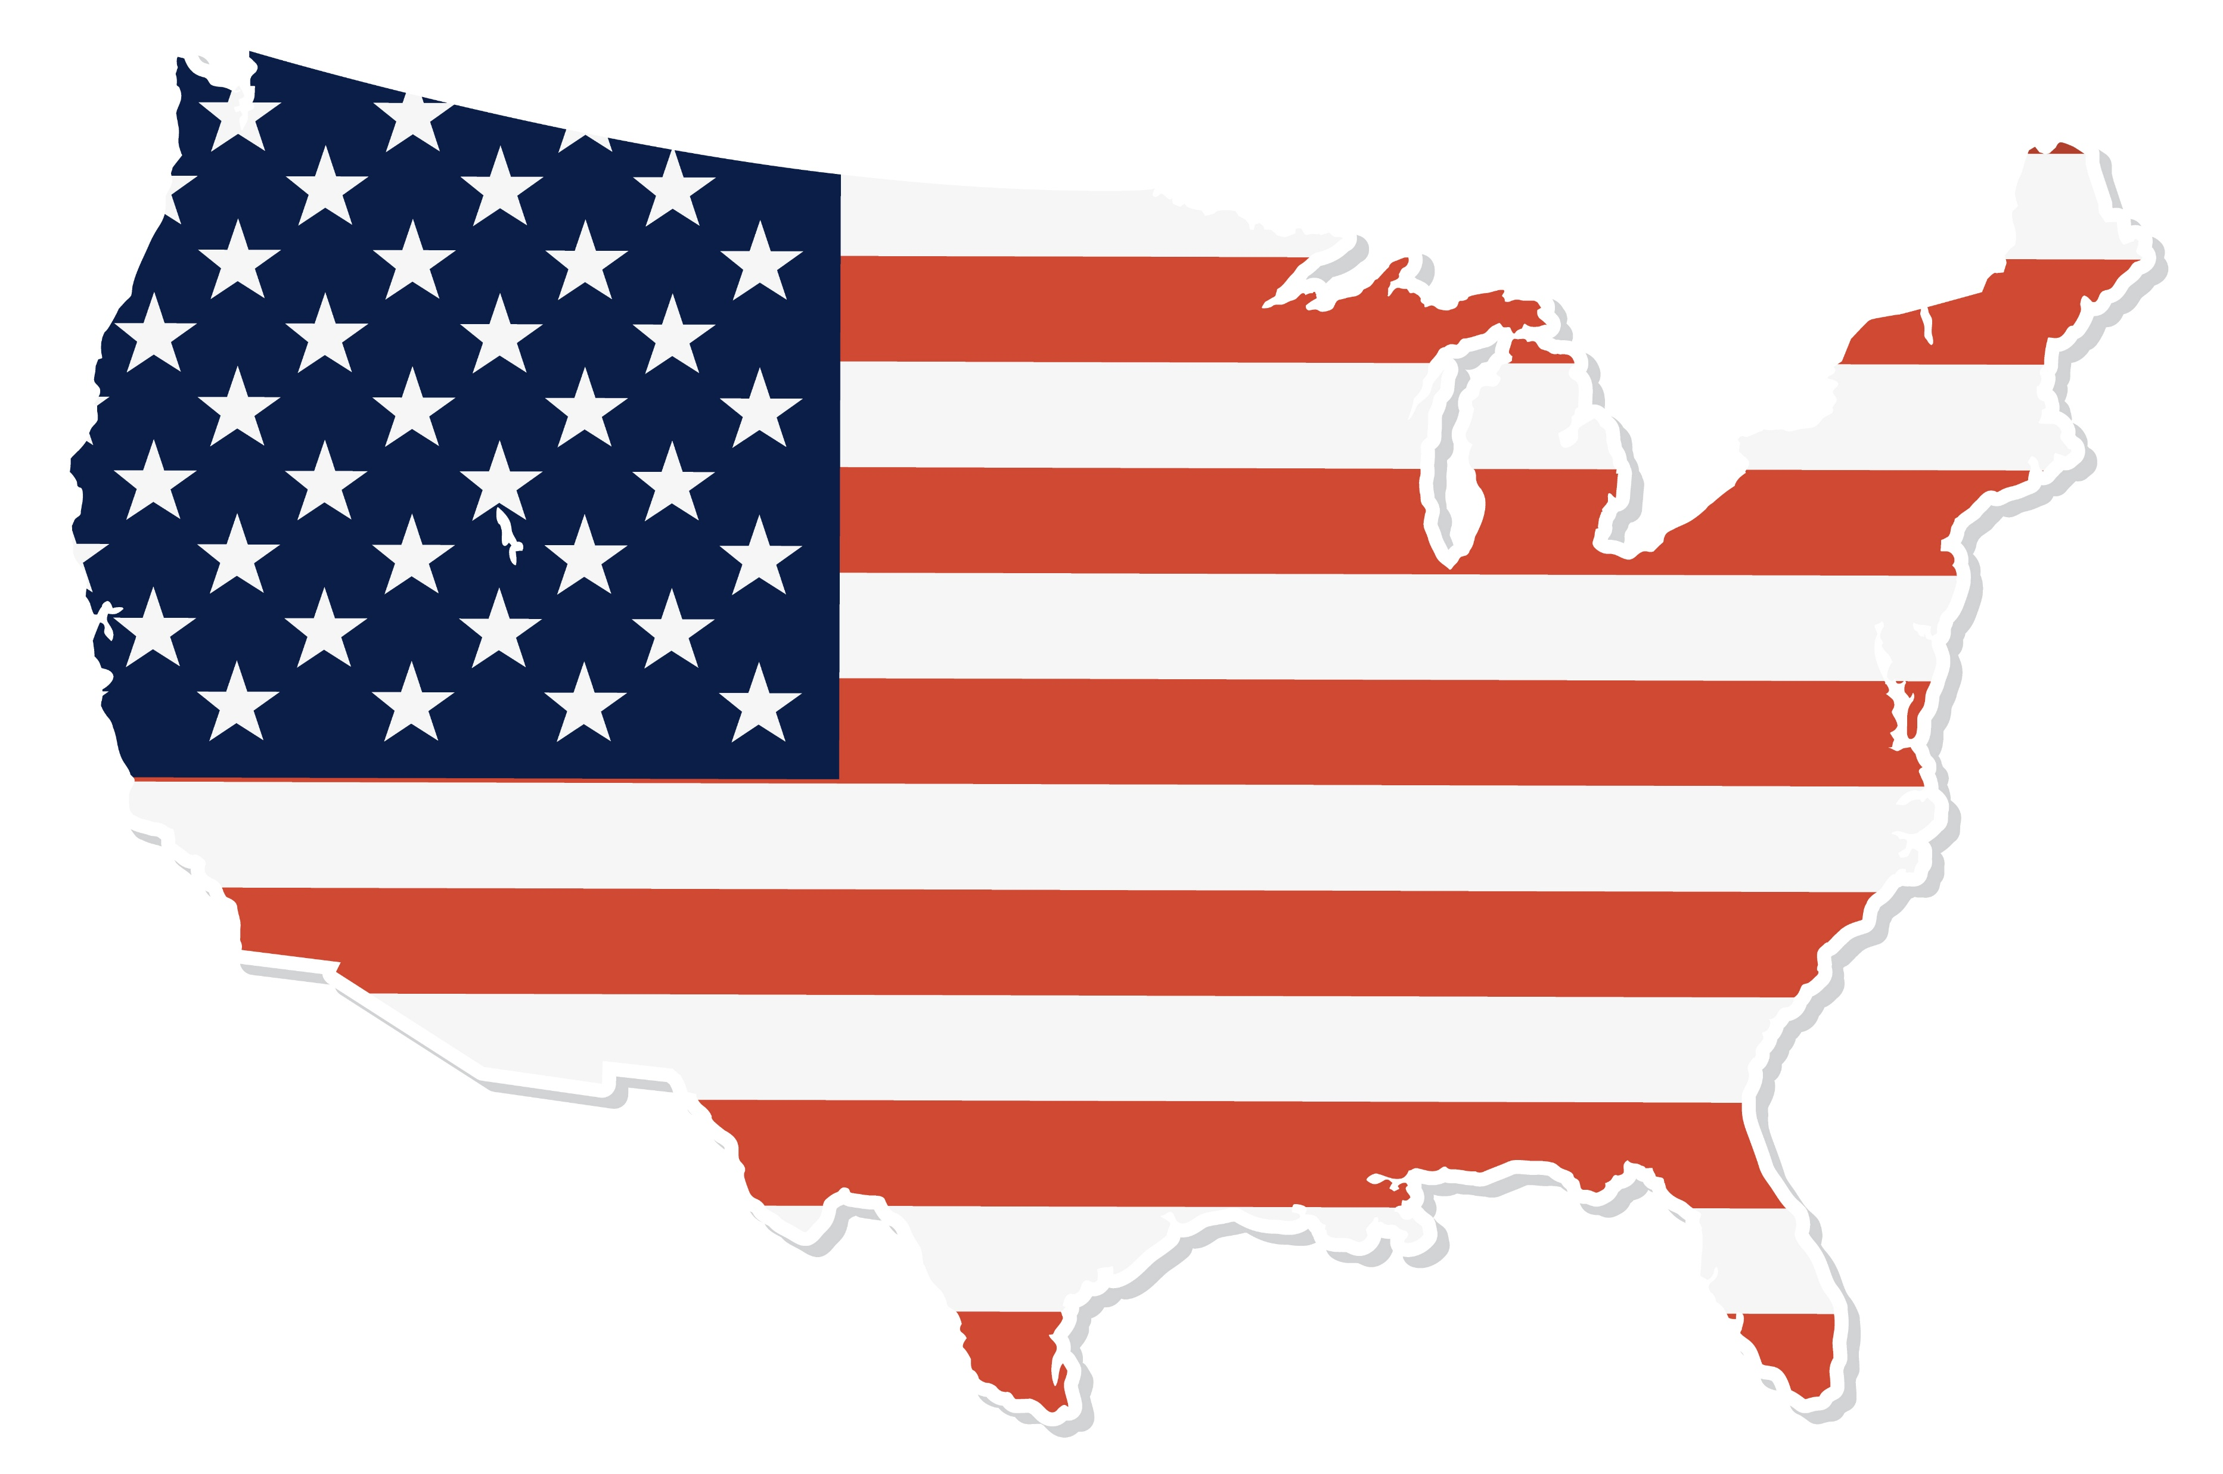

Problem Statement
AtliQ Motors is planning to expand its electric vehicle (EV) business into India.
Despite rapid EV adoption in India, the market is highly diverse across states, vehicle categories, and policy environments.
AtliQ Motors currently lacks clarity on:
High-growth states and EV penetration patterns
Demand drivers for 2-wheelers vs 4-wheelers
Revenue potential and future market size
Impact of subsidies, charging infrastructure, and seasonality
A data-driven market study is required to identify opportunities, minimize risk, and guide strategic entry decisions.

Slide 3
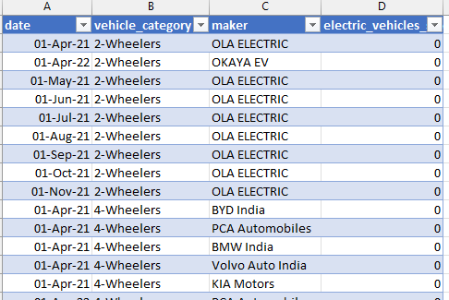
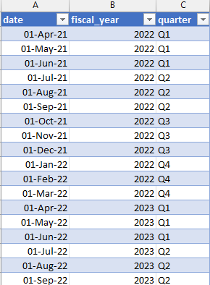
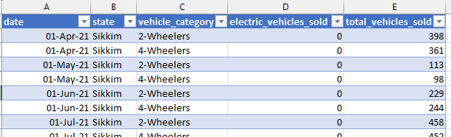

Slide 4
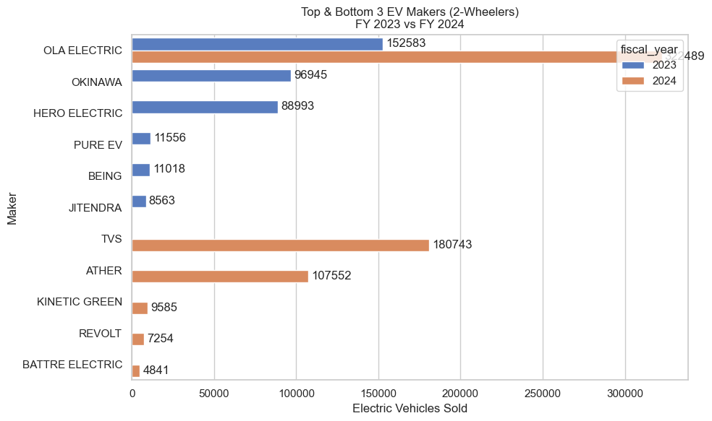
1. List the top 3 and bottom 3 makers for the fiscal years 2023 and 2024 in terms of the number of 2-wheelers sold

Slide 5
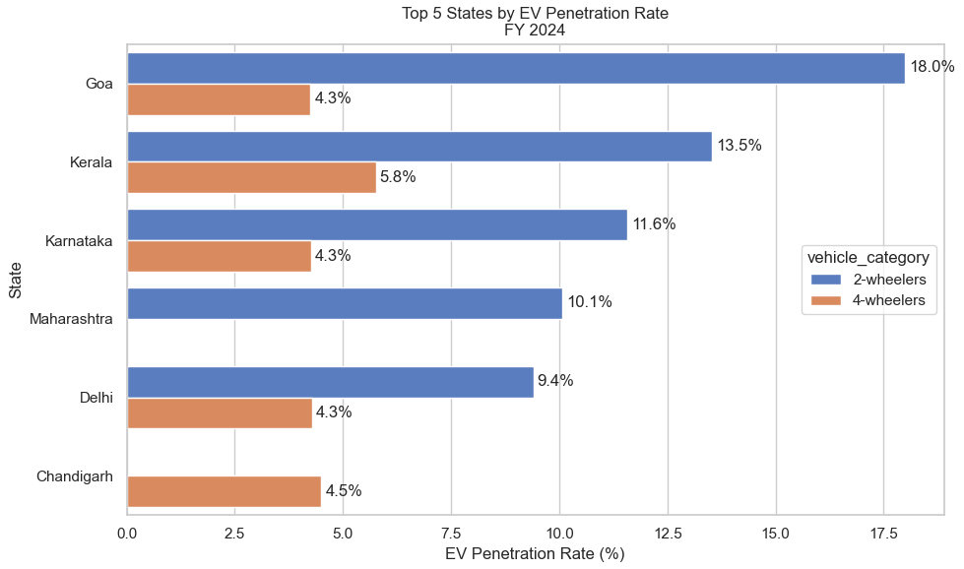
2. Identify the top 5 states with the highest penetration rate in 2-wheeler and 4-wheeler EV sales in FY 2024.

Slide 6
3. List the states with negative penetration (decline) in EV sales from 2022 to 2024?
Conclusion : An analysis of EV penetration trends between FY 2022 and FY 2024 shows that no Indian state with continuous data experienced a decline in EV penetration rate. While some states lacked data for FY 2022 and were excluded from comparison, all comparable states demonstrated stable or increasing EV adoption relative to total vehicle sales.

Slide 7
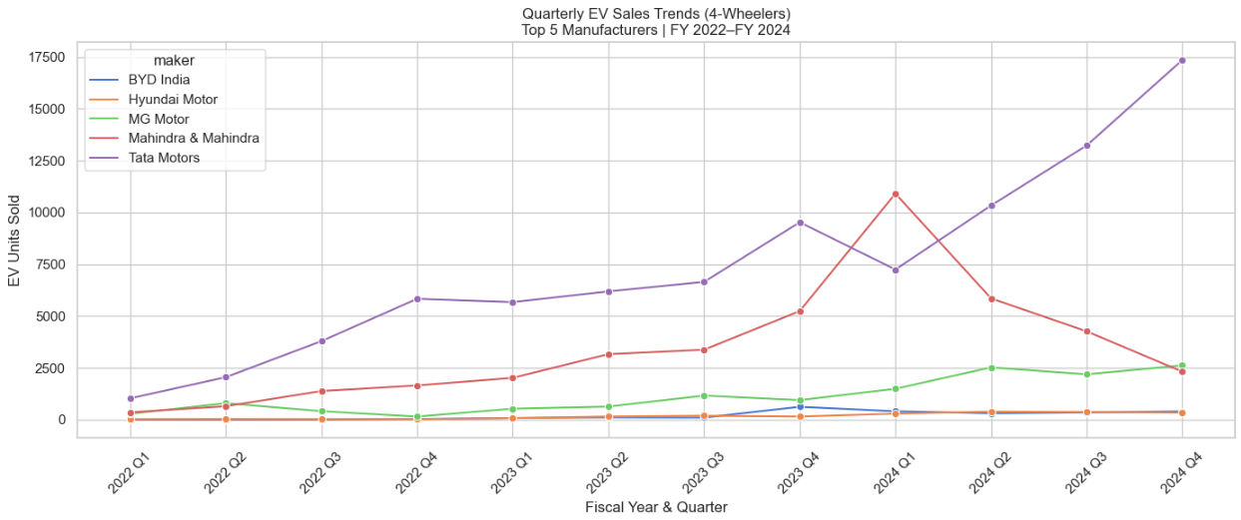
4. What are the quarterly trends based on sales volume for the top 5 EV makers (4-wheelers) from 2022 to 2024?

Slide 8
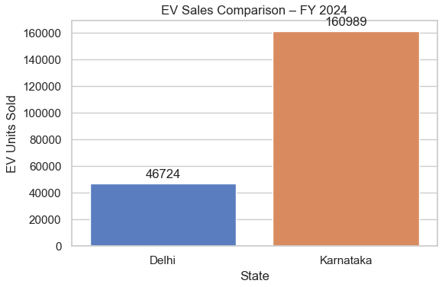
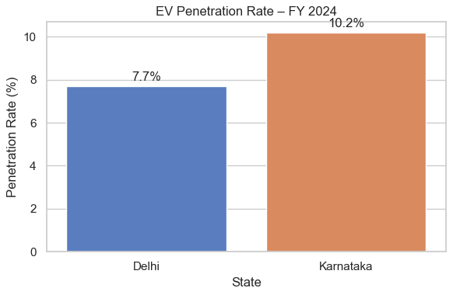
5. How do the EV sales and penetration rates in Delhi compare to Karnataka for 2024?
“In FY 2024, Karnataka sold over 160,000 EVs compared to around 47,000 in Delhi, making it more than three times larger in market size. At the same time, Karnataka also shows a higher EV penetration rate at 10.2%, compared to 7.7% in Delhi. This tells us that Karnataka is not only a larger EV market but also a more mature one in terms of adoption. For AtliQ Motors, this makes Karnataka the strongest candidate for volume-driven entry, while Delhi can play a supporting role for policy-led branding and visibility.”

Slide 9
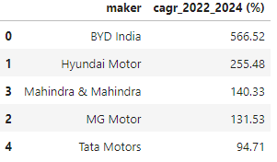
6. List down the compounded annual growth rate (CAGR) in 4-wheeler units for the top 5 makers from 2022 to 2024.
What this table shows (set the frame)
This table ranks the top 5 EV manufacturers in the 4-wheeler segment by their compound annual growth rate (CAGR) between FY 2022 and FY 2024.
Metric: CAGR (%)
Time period: 2 years
Interpretation: Average annual growth rate in EV sales

Slide 10
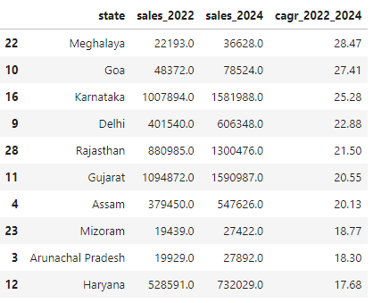
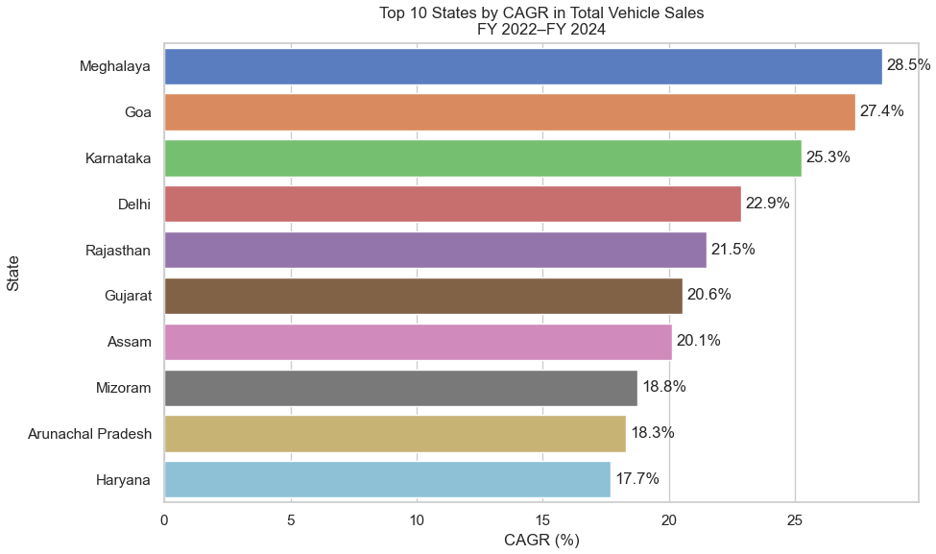
7. List down the top 10 states that had the highest compounded annual growth rate (CAGR) from 2022 to 2024 in total vehicles sold.

Slide 11
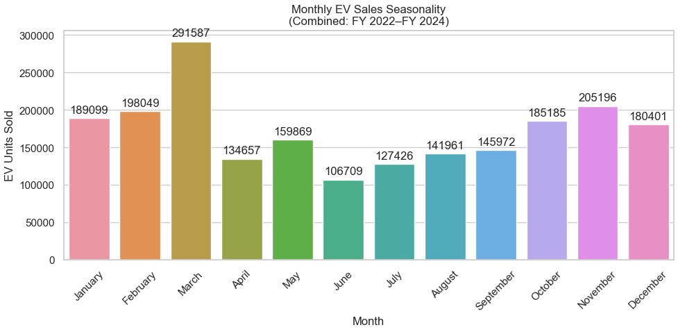
8. What are the peak and low season months for EV sales based on the data from 2022 to 2024?
Analyzing EV sales data from 2022 to 2024 reveals a clear seasonal pattern. March consistently emerges as the peak month for EV sales, driven by financial year-end purchasing, institutional procurement, and dealer-led incentives. In contrast, June records the lowest sales volumes, reflecting post–year-end demand fatigue and the onset of monsoon-related purchase deferrals.

Slide 12
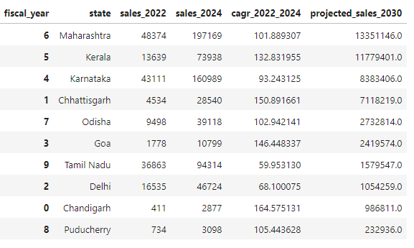
9. What is the projected number of EV sales (including 2-wheelers and 4- wheelers) for the top 10 states by penetration rate in 2030, based on the compounded annual growth rate (CAGR) from previous years?

Slide 13
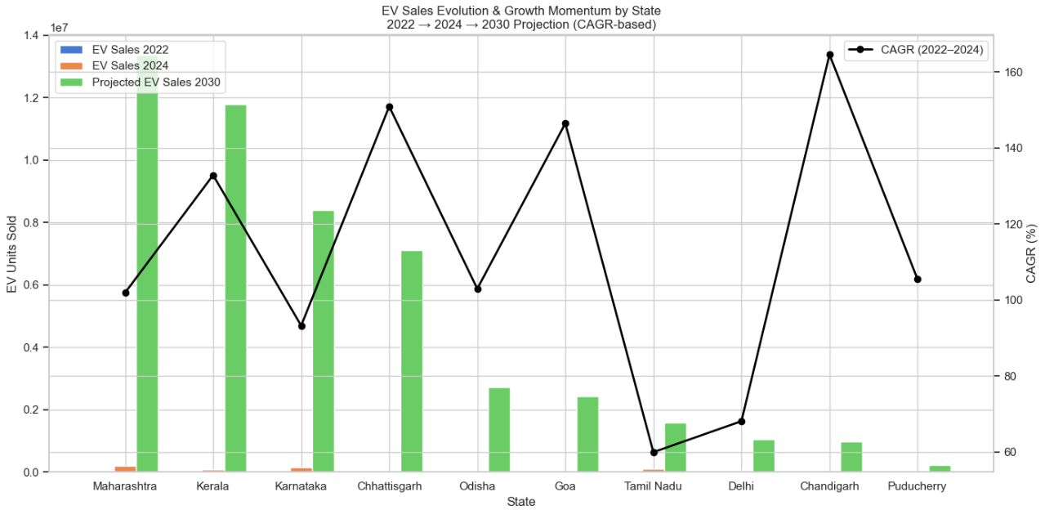
This chart shows how EV sales have evolved from 2022 to 2024 and what that growth implies for 2030. While states like Chhattisgarh and Chandigarh exhibit very high CAGR due to small starting bases, Maharashtra, Karnataka, and Kerala stand out by combining strong growth momentum with large absolute volumes. This makes them the most strategically important EV markets over the next decade.

Slide 14

10. Estimate the revenue growth rate of 4-wheeler and 2-wheelers EVs in India for 2022 vs 2024 and 2023 vs 2024, assuming an average unit price. H
Vehicle Category | Avg Price
2-Wheelers | ₹85,000
4-Wheelers | ₹15,00,000
Important assumptions:
Prices are constant across years
Revenue growth is driven only by volume growth
All values are estimated, not actual reported revenue

Slide 15
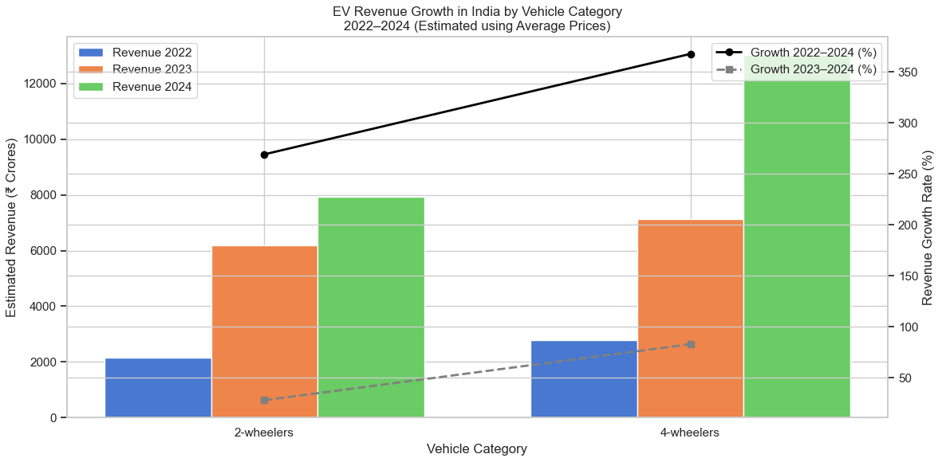
While 2-wheelers continue to drive mass EV adoption in India, the revenue story is increasingly dominated by 4-wheelers. Between 2022 and 2024, 4-wheeler EV revenue grew faster and reached a higher absolute level than 2-wheelers, driven by higher unit prices and accelerating demand. This indicates a clear shift toward monetization and premiumization in India’s EV market.

Slide 16
Secondary Research Questions
1. What are the primary reasons for customers choosing 4-wheeler EVs in 2023 and 2024 (cost savings, environmental concerns, government incentives)?
Insight (short): Buyers chose 4-wheeler EVs primarily for total cost of ownership (running-cost savings) and features/comfort (vehicle utility and safety), with environmental concern and government incentives as secondary but meaningful motivators.
What it means for AtliQ Motors: Messaging that emphasizes (a) lower running cost over the vehicle lifecycle, (b) product features (range, safety, interior comfort), and (c) environmental benefit will map to buyer priorities. Incentive messaging should be part of the purchase funnel.
Recommendation / next step:
Lead with a “Total Cost of Ownership” (TCO) calculator on the website (showing fuel + maintenance savings vs ICE).
Promote feature comparisons (range, warranty, safety) in dealer communications.
Include clear, localized subsidy information per state at point-of-sale. (Backing: consumer intention & adoption literature.)

Slide 17
2. How do government incentives and subsidies impact the adoption rates of 2-wheelers and 4-wheelers? Which states in India provided most subsidies?
Insight (short): Subsidies materially accelerate adoption (they lower entry cost and improve ROI). States with clear, generous state incentives + administrative ease show higher uptake where charging and supply chains exist. Delhi, Gujarat, Maharashtra, Uttar Pradesh and several other states have offered notable buyer/charging subsidies. .
What it means for AtliQ Motors: Where buyer subsidies are stronger, price-sensitive segments adopt faster — especially for 2-wheelers and lower-priced 4-wheelers. For 4-wheelers, capital subsidy + registration / tax breaks in a state can shorten payback and accelerate sales.
Recommendation / next step:
Maintain a state-subsidy lookup in the dealer CRM so sales teams can quote net price instantly. (Use e-AMRIT / state portals as sources.)
Prioritize roll-out in a mix of (a) states with high subsidies and (b) high absolute demand (e.g., Maharashtra, Karnataka, Gujarat).
Negotiate with state governments for targeted incentives tied to local manufacturing or charger rollout. (State policy examples show capital subsidy for chargers in Gujarat.)

Slide 18
3. How does the availability of charging stations infrastructure correlate with the EV sales and penetration rates in the top 5 states?
Insight (short): Public charging station density correlates positively with EV sales/penetration at the state level — states that invested in public and fast-charging networks (and grid readiness) show higher EV adoption rates. JMK / BEE data indicate public charger counts and their state distribution, and NITI/BEE policy notes show infrastructure rollout is a central driver. .
What it means for AtliQ Motors: Entering or scaling in a state with a robust charging network reduces range anxiety and dealer returns. Conversely, where chargers are sparse, AtliQ should invest in private fast-charging partnerships or offer home/office charger incentives.
Recommendation / next step:
For launch states (e.g., top penetration states in your analysis like Karnataka, Kerala, Maharashtra), form partnerships with public charging providers and oil-majors converting petrol stations to EV chargers (many states are enabling this).
Offer bundled “home charger + first year public-charging credits” for early buyers in low-infrastructure districts.
Map charger density vs penetration (your Q2/Q7 outputs) and make it an explicit launch-criteria matrix.

Slide 19
4. Who should be the brand ambassador if AtliQ Motors launches their EV/Hybrid vehicles in India and why?
Insight (short): Choose an ambassador who signals trustworthiness, sustainability credibility, and wide urban & youth appeal. For an EV brand, a sustainability advocate or a high-trust sports personality is often more effective than a generic film star tied to another auto brand. Two candidate approaches: (A) a sustainability-focused celebrity (e.g., Jackie Shroff ) for credibility, or (B) a popular sports star with pan-India reach (e.g., M.S Dhoni or another high-trust athlete) for mass appeal. .
What it means for AtliQ Motors:
If AtliQ wants trust & sustainability positioning (premium EV/HYBRID eco story): pick a credible environmental advocate (e.g., Jackie Shroff).
If AtliQ wants mass adoption & performance positioning (sporty, aspirational models): pick a high-trust athlete or youth icon (e.g., M.S Dhoni ).
Recommendation / next step:
Run a small brand-fit survey with ~1,000 respondents in target metros to test three choices (environment champion vs athlete vs mainstream film star) and measure “trust” + “relevance” + “appeal.” (This is cheap and prevents mis-spend.)
If budget allows, structure the ambassador deal to include sustainability campaign elements (tree planting, community charging hubs) to make the partnership authentic. (Research shows authentic fit matters.)

Slide 20
5. Which state of India is ideal to start the manufacturing unit? (Based on subsidies provided, ease of doing business, stability in governance etc.)
Insight (short): For a mix of incentives, industry ecosystem, supplier base, and logistics, Maharashtra, Gujarat, Tamil Nadu, and Karnataka are the strongest candidates. Maharashtra and Gujarat are currently very active in EV manufacturing incentives; Tamil Nadu & Karnataka have deep automotive supplier ecosystems and skilled labour pools. .
What it means for AtliQ Motors: Choosing a state involves a trade-off: incentive generosity (Gujarat, Maharashtra) vs supplier ecosystem & labour (Tamil Nadu, Karnataka). For quick scale and supplier proximity, Tamil Nadu / Karnataka are excellent; for greenfield incentives and charger subsidy support, Gujarat / Maharashtra may be better.
Recommendation / next step:
Shortlist top 3 states (e.g., Maharashtra, Gujarat, Tamil Nadu) and run a 30-day site selection study that models: land cost, power availability (grid stability), supplier proximity, incentives value (one-time vs recurring), and time-to-approval. (Government portals & BRAP/EoDB rankings are input sources.)
Negotiate a performance-linked incentive (PLI) package tied to local employment and local supplier sourcing to reduce capex. Many state EV policies are open to such deals.

Slide 21
6. Your top 3 recommendations for AtliQ Motors.
Launch where demand + infrastructure meet — then scale
Priority: start sales rollout in states that combine high EV penetration and charger density (e.g., Karnataka, Maharashtra, Kerala) and immediately form public/private charging partnerships. (Charging data & NITI guidance support this.)
Product + Price + Policy playbook
Develop two launch SKUs - Stock Keeping Unit (one distinct vehicle model/variant) : (A) value-priced 2-wheeler (high volume) and (B) 1or 2 4-wheeler variants (higher margin). Combine with a state wise subsidy navigator at dealer level to show net price after incentives. (Studies show cost & incentives strongly influence adoption.)
Infrastructure & credibility investments before scale
Commit to (a) a branded charging partnership (public + home installers), (b) a credible sustainability ambassador/partnership (e.g., an environment champion for brand authenticity), and (c) a pilot local manufacturing / CKD (Completely Knocked Down) → local assembly step negotiated with a chosen state for incentives. This reduces buyer risk, improves trust and obtains government buy-in.

